Slide 1


Causes and Effects of Climate Change

Slide 2
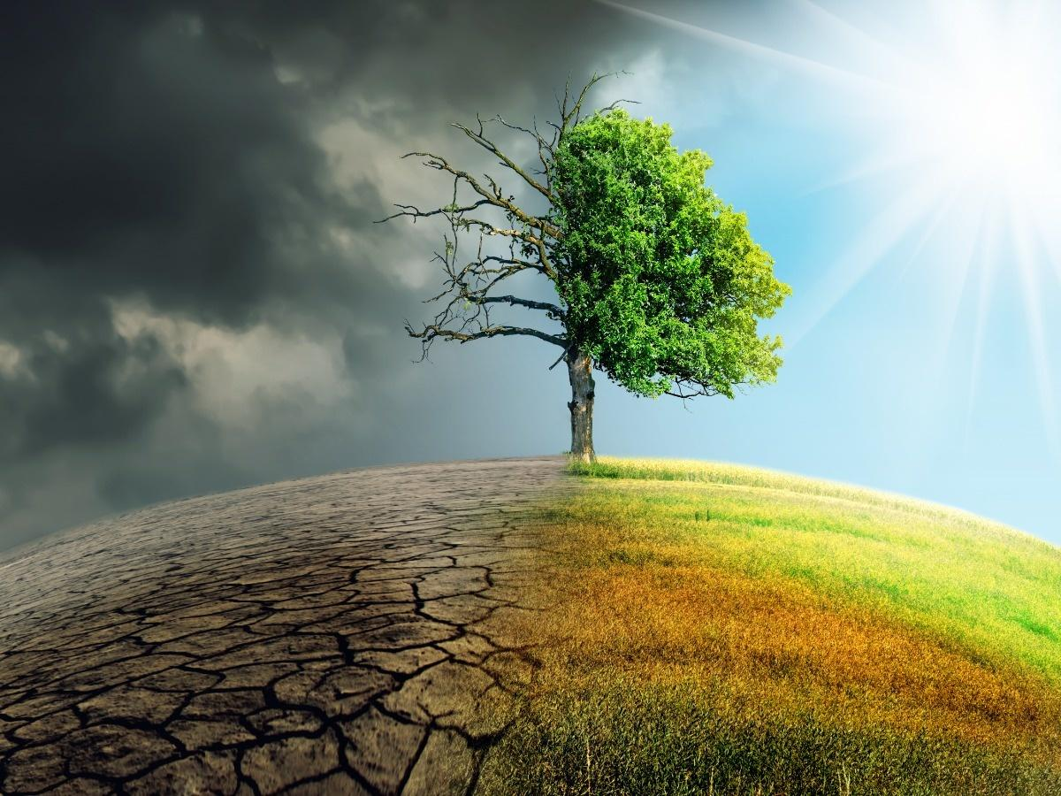
What is Climate change
Climate change is described as a change in the average conditions — such as temperature and rainfall — in a region over a long period of time

Slide 3

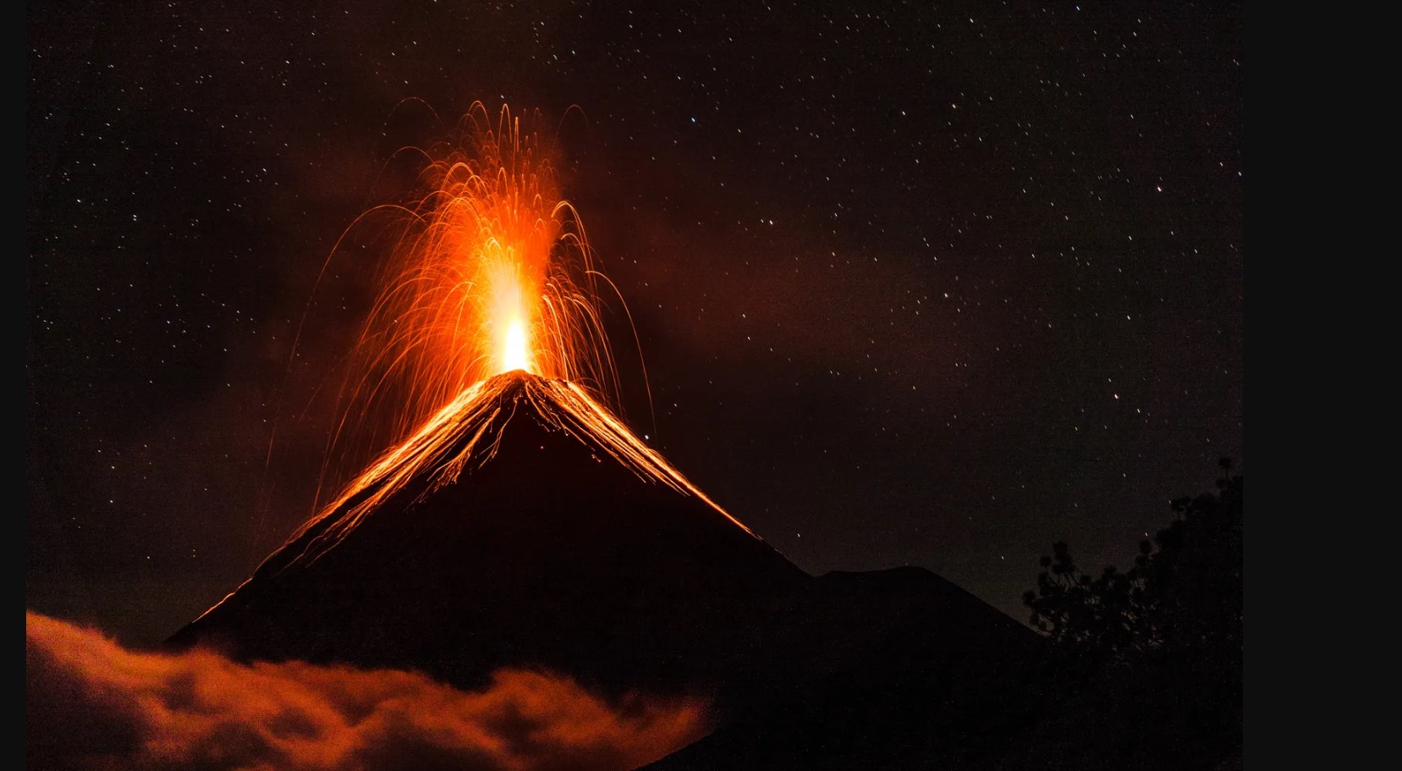
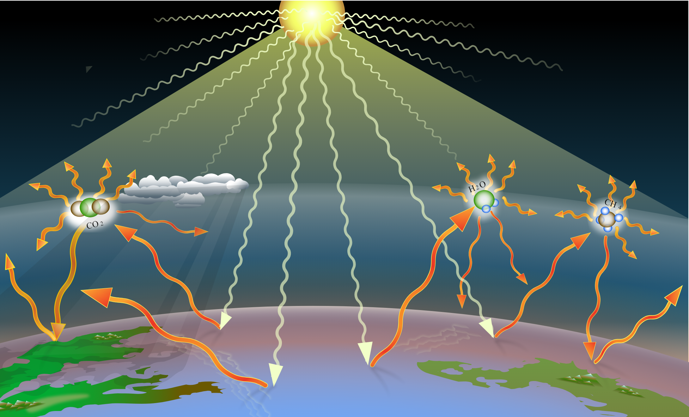
Causes of climate change:
The causes of climate change in two segments. They are:
Natural Cause
Man-made causes
Natural Cause:
Greenhouse Gas
Volcanic eruption
Solar variability

Slide 4
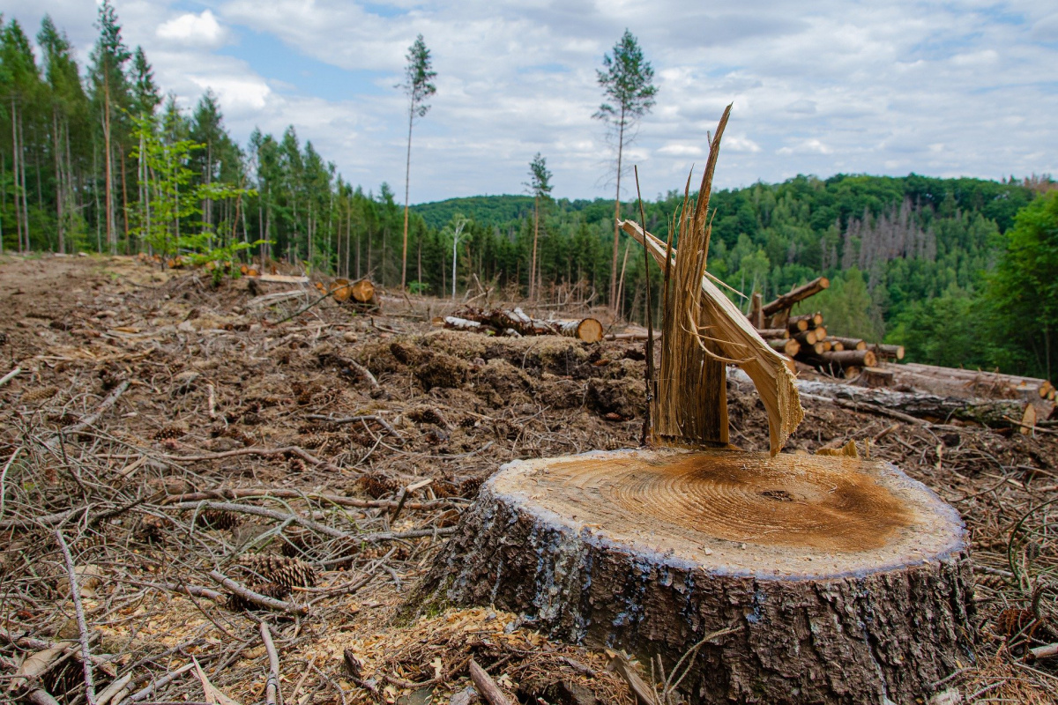
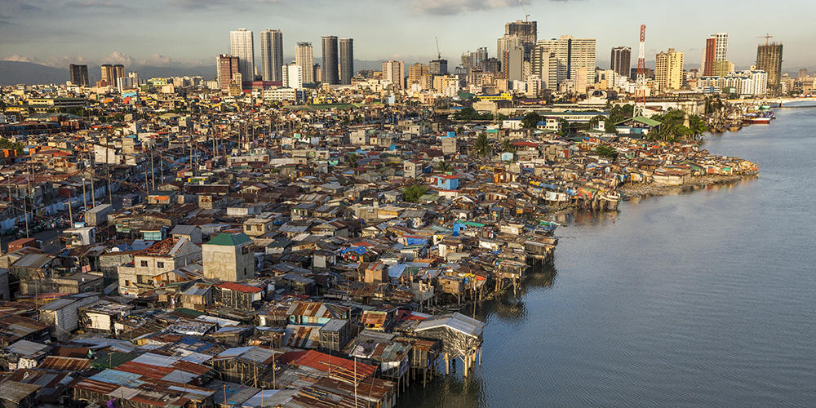
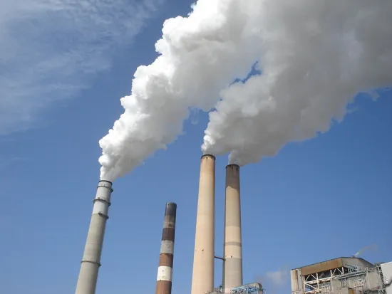
Causes of climate change:
Man made Cause
Human activities
Urbanization
Deforestation
Rising emission
Generating power
Increasing livestock farming
Manufacturing Goods
Fluorinated gases

Slide 5
Effects of Climate change:
The effects of climate change are categorized in three categories:
Environmental Effect
Social Effect
Economical Effect

Slide 6
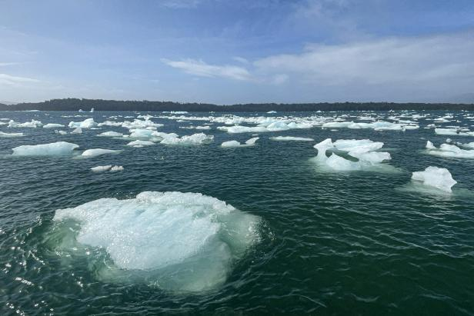
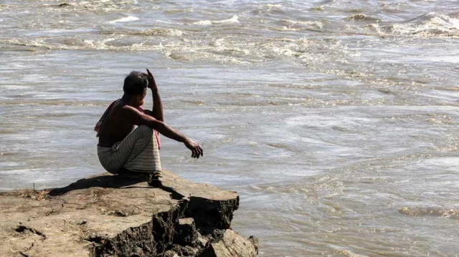
Effects of Climate change:
Environmental Effect
Sea Rise Level
Extreme Weather Events
Temperature Rise
Riverbank Erosion
Melting glaciers
Change in ecosystem

Slide 7
Effects of Climate Change:
Social Effect
Food security
Health and disease
Migration and displacement
Economical Effect
Agriculture
Food and Beverage industry
Marine Economy & Fisheries

Slide 8
Recommendation
Providing dustbins at a close distance and applying strict rules for not using it.
Arranging different programs for the younger generation to educate them about the climate change
Punishing people for illegal logging and rewarding people for afforestation and reforestation.
Developing eco friendly urban planning for increasing green space and the use of renewable energy source.

Slide 9
Recommendation
Reduce Greenhouse Gas Emissions
Promote Sustainable Agriculture and Land Use
Strengthen Climate Policies and International Cooperation
Invest in Climate Adaptation and Resilience:

Slide 10
Thank You

